Slide 1






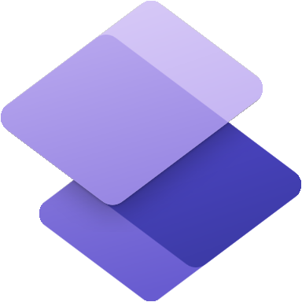

Microsoft Power Platform
Community call
Welcome to the June 2022
Power Platform Community Call!
June 15th, 2022
Notes:
Hello and thank you for joining us today. Welcome to the June 2022 Power Apps Community Call! I’m Todd Baginski and I'm really excited to bring you another fun month of Power Apps goodness.
Monthly cadence
Every month on the ‘third’ Wednesday
Next call: May 18th, 2022 - 08:00am PST
Latest news and community contributions
Meet the product teams behind Power Apps
Technical deep dives
The Power Apps Community Call chat channel includes Microsoft Power Apps team members, Fast Track Recognized Solution Architects, Power Apps MVPs, Power Apps Champions, and #PowerAddicts!
Q&A

Slide 2
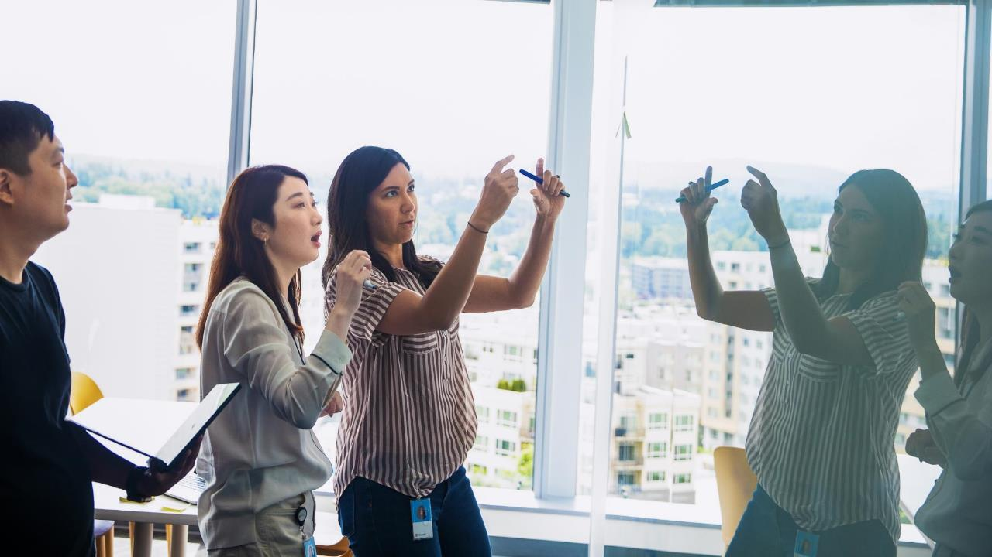


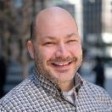
Agenda
Latest updates and news on Power Platform
Group picture time with Together Mode!
Demos
Kristine Kolodziejski - Taking your Power Apps mobile navigation UI to the next level!
Hugo Bernier – Power to the Pages – Introduction to Power Pages!

Slide 3

Community Call Format
Community Updates (15 Minutes)
Demo #1 (15 Minutes)
Demo #2 (15 Minutes)
Demo #3 (15 Minutes)

Slide 4
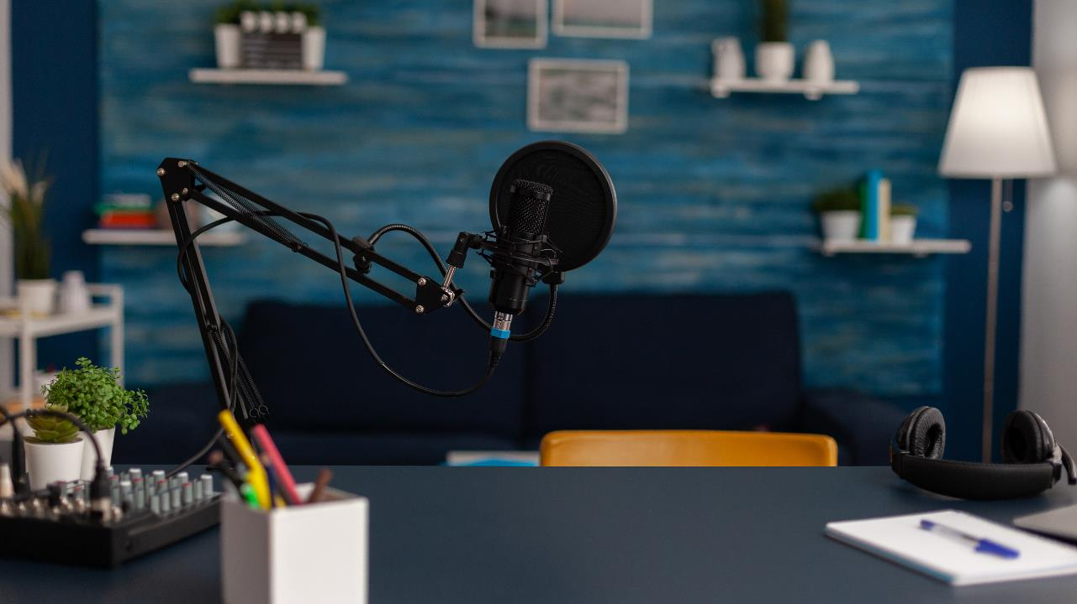
Request to Present We welcome everyone to present a demo on the Power Platform Community Call. Everyone is welcome!!!
https://aka.ms/PPCCDemoRequest

Slide 5
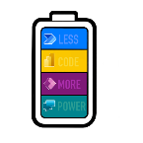
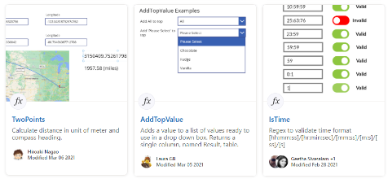
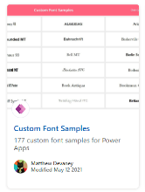
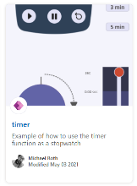
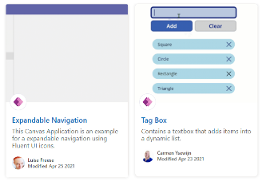
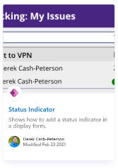
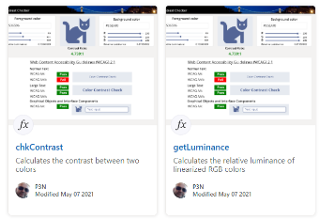
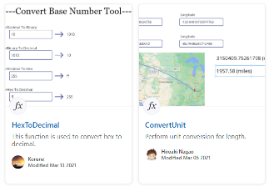
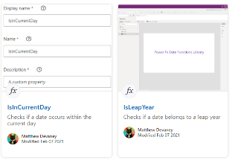
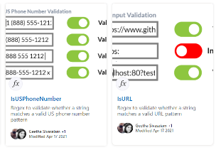
Power Platform Samples
https://aka.ms/powerplatform-samples ​
https://adoption.microsoft.com
Power Apps templates​
Power Apps components​
Power Apps connectors​
Power Fx Custom Functions
Power Automate flow templates​​
PowerBI​​
Power Virtual Agents​​

Slide 6
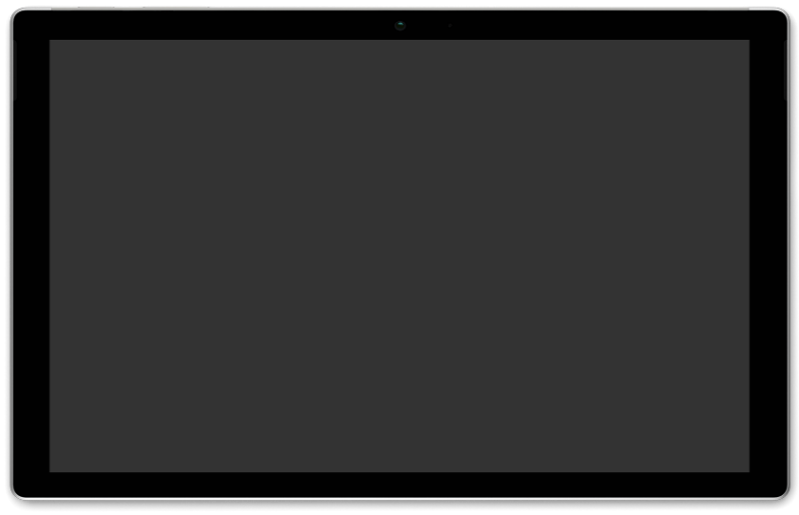
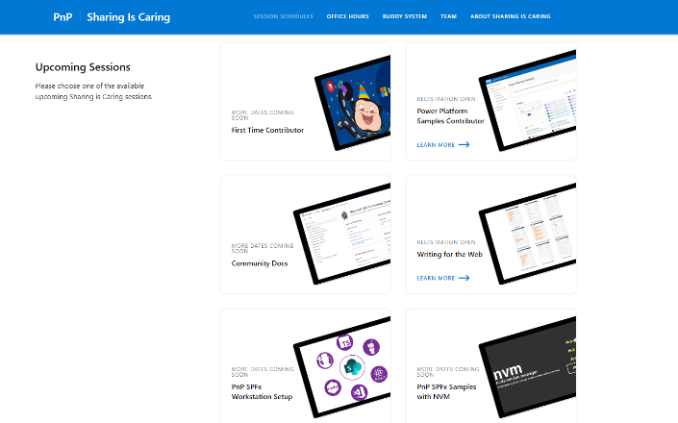
GUIDANCE
Learn how to get started in the open-source community!
Upcoming Sessions:
First-time contributor
Power Platform Samples Contributor
Writing for the Web
Community Content Docs
SPFx Developer Workstation Setup
Using PnP SPFx samples w/ NVM
More than code with VS Code
Coming Soon: Power Pages -- 2 Part Session
Join the Power Platform Contributors
Sharing is Caring Session – June 29th
https://aka.ms/sharing-is-caring
Notes:
25 Total attendees, 16 attendees who attended both First-Time Contributors and Community Docs sessions.

Slide 7








COMMUNITY
Community Recognition Program
Showcasing your contributions
Powered by Credly
More achievement levels coming soon
https://aka.ms/m365pnp-recognition
Notes:
25 Total attendees, 16 attendees who attended both First-Time Contributors and Community Docs sessions.

Slide 8

Power Platform Community Events

Slide 9
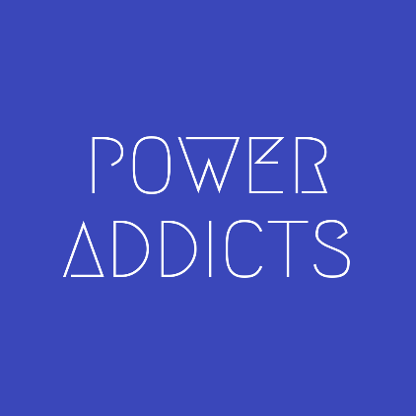
Power Addicts Hangout
#PowerAddict : An individual with an almost obsessive need and desire to bring positive change, solve problems and automate processes with the Microsoft Power Platform.
https://WeArePowerAddicts.com

Slide 10
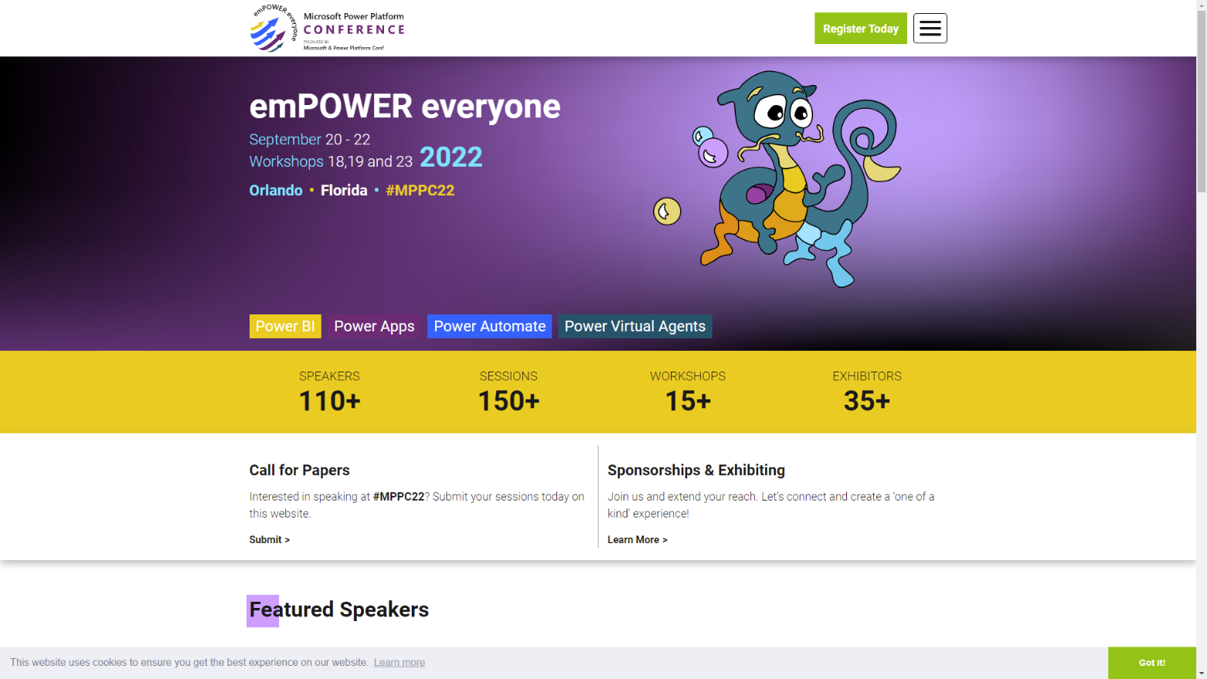
https://powerplatformconf.com/

Slide 11




Slide 12
Recent News

Slide 13
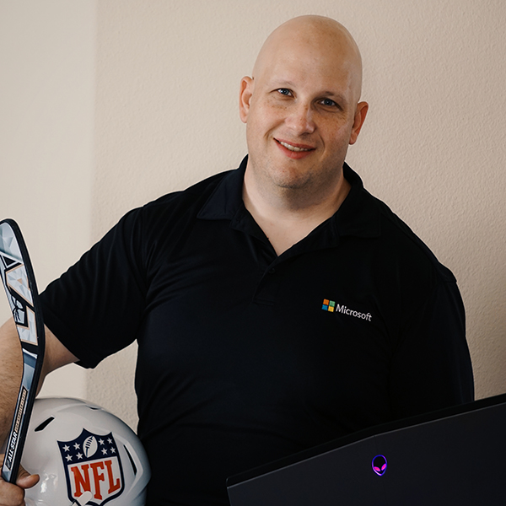
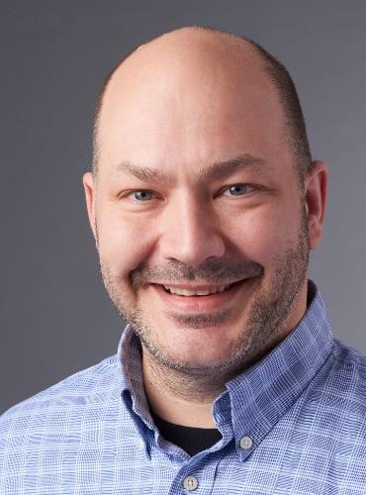

Welcome Hugo Bernier Pr. Program Manager (Community Program Manager), Power Pages Hugo Bernier fell in love with programming when he was 12 year old; when he was 16, he started his own software consulting company, and has lived out this quote by Mark Twain ever since: “Find a job you enjoy doing, and you will never have to work a day in your life“ As a consultant specializing in practice building at McKinsey & Company, he learned to combine his passion for programming with his love of problem solving, public speaking, and community-building; this passion took him to Singapore, Germany, Finland, Australia, Hungary, South Africa, Japan, Indonesia, France, the UK, and Malaysia. He has worked with SharePoint since it was codenamed “Tahoe” and became an MVP and a member of the Microsoft 365 Patterns and Practices team, where he worked on community initiative such as the Sharing is Caring program, the sample galleries, the community blog, and the recognition program.
Notes:
Hello everyone, I’ve joined our Engagement & Growth team under Heather Newman about 1 month ago. I was previously in DTP, working in the FastTrack team engaging with our largest customers in EMEA and South America.
I’ve worked in some initiatives that you may have heard about such as the Success by Design Framework and unification across CE and F&O and the recently launched Implementation Guides.
I’m very excited to work with Community, focusing on growing, enabling and supporting our members and MVP’s and doing the bridge between Engineering and the community.
Thank you.

Slide 14




Microsoft Power Platform
No code, low code, and code first—all are welcome
Power BI Business analytics
Power Apps Application development
Power Automate Workflow automation
Power Virtual Agents Intelligent virtual agents

Slide 15

Microsoft Power Platform
No code, low code, and code first—all are welcome
Power BI Business analytics
Power Apps Application development
Power Pages Website Development
Power Automate Workflow automation
Power Virtual Agents Intelligent virtual agents

Slide 16
Microsoft Power Platform
No code, low code, and code first—all are welcome
Power BI Business analytics
Power Apps Application development
Power Pages Website Development
Power Automate Workflow automation
Power Virtual Agents Intelligent virtual agents

Slide 17
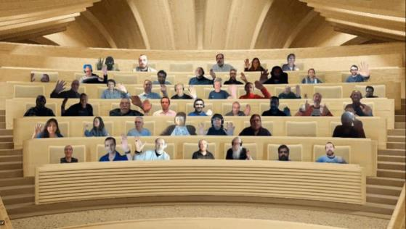

Optional picture time!
Turn your video on and we’ll grab a Together Mode picture with everyone willing to participate.
We are together in this as a community!
By enabling your camera for the picture, you’ll give us the permission to share your picture in social media.

Slide 18


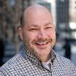
DEMO
Taking your Power Apps mobile navigation UI to the next level
– Kristine Kolodziejski
Power to Pages – Introduction to Power Pages
– Hugo Bernier
Notes:
Notes about each demo go here.

Slide 19
Q&A

Slide 20
Resources

Slide 21
Learn more with these helpful resources!
Power Apps Training Resources
https://aka.ms/PowerAppsTraining
Power Apps Community
https://Community.PowerApps.com
Power Apps Community Samples
https://aka.ms/PowerAppsCommunitySamples
Power Apps Community Videos
https://aka.ms/PowerAppsCommunityVideos
PowerPlatformLearn Resources
https://www.powerplatformlearn.academy
PnP Power Platform Samples
https://www.aka.ms/powerplatform-samples
Create SharePoint List
https://bit.ly/CreateSharePointList

Slide 22
Microsoft 365 developer community calls
Microsoft 365 platform (weekly) https://aka.ms/m365-dev-call
(Notice. This call is on a summer break between July 1st and 31st of August 2022)
Adaptive Cards https://aka.ms/adaptivecardscommunitycall
Microsoft identity platform https://aka.ms/IDDevCommunityCalendar
Office Add-ins https://aka.ms/officeaddinscommunitycall
Power Platform https://aka.ms/PowerPlatformCommunityCall
Microsoft 365 & Power Platform Development (bi-weekly) https://aka.ms/m365-dev-sig
Viva Connections & SharePoint Framework (bi-weekly) https://aka.ms/spdev-spfx-call
Download recurrent invites from
https://aka.ms/m365/calls
Notes:
m365-dev-sig

Slide 23
Thank you
Recording will be available soon on the
Microsoft 365 Community (PnP) YouTube channel
https://aka.ms/M365PnP/videos
(subscribe today)
Follow us on Twitter
@Microsoft365Dev | @M365PnP
Next call: July 20, 2022 at 08:00am PST
https://aka.ms/powerplatformcommunitycall
See all other community calls at http://aka.ms/m365pnp

